Slide 1
Review of Classical Mechanics
Student’s Name
Institution affiliation

Slide 2
Classical Mechanics
Classical mechanics was adopted from Galileo (1584-1642)
Newton came with his first law of mechanics from Galileo law of falling bodies
Between 1642 to 17217 Newton came with 3 laws of motion
In the law of motion, he stated that velocity is constant when force is zero (Britannica, 2021).
Notes:
Newton classical mechanics were developed from the work of scientist called Galileo between 1584 and 1642.
These ideas made him come with the first law which generally focused on the law of motion. He didn’t change Galileo ideas but expanded them since Galileo was focusing on the falling bodies. The law of motion was basically developed on ideas of the velocity and force.
For instance, he argued that a body will remain at rest unless force in applied and this meant that velocity is constant when F=0. This indicated that a body cannot move unless there is some force applied on the body (Britannica, 2021).

Slide 3
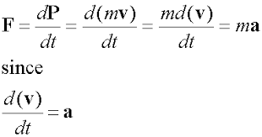
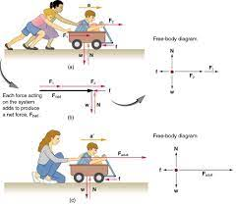
The second law of motion stated that the body acted upon by the force has change of momentum equal the force
P=F, where p=mr which is body linear momentum
For the equation m is the mass while r is the position vector
Then r given as r=dr/dt, where the derivative is with respect to t
From the second law F=mr is generated
He also stated that if two bodies exert force on each other, they have the same magnitude and opposite direction
Notes:
When the body is acted upon by the force, the rate of change of momentum will be equal to the force. This is given by the equation P=F where momentum (p) is qual to mass (m) multiplied by position vector (r).
position vector (r) is obtained from the derivative of dr/dt with respect to t. Therefore, obtaining r is simply differentiation with respect to t.
The final formular generated from the second law of motion is F=mr, because momentum after force has been acted will be P=F.
These ideas were developed from how Galileo explained the falling bodies, he changed the momentum they used and the force that they would impact on the surface to come up with the conclusion of the moving body.

Slide 4
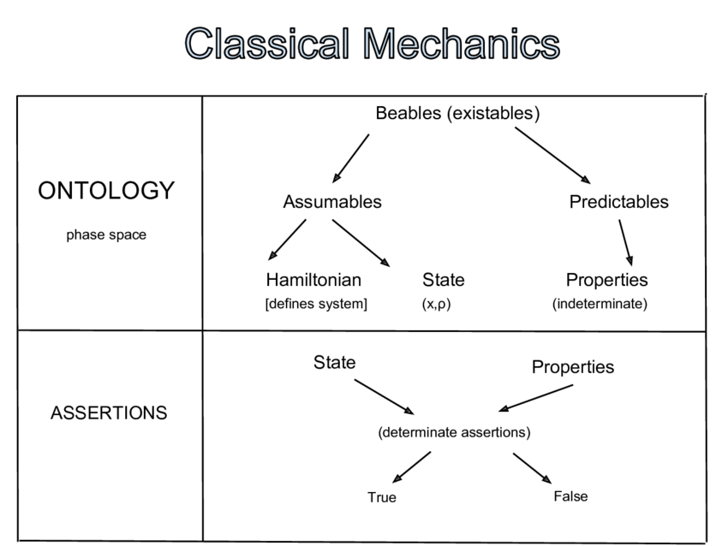
Classical mechanics is the Newton’s second law
The law state that for a particle with definite mass, the time rate of the momentum change is proportional to force
He stated that the particle with mass m and velocity v will have the momentum as mv.
In the equation there is applied force (Fj) and F which is the resultant force (Britannica, 2021).
Notes:
Classical mechanics is the Newton’s second law, after he developed the first law, Newton saw there was a need to develop the second law which would explain his ideas properly.
The law that for a particle with a definite mass, the time of the momentum change is proportional to force.
He developed the ideas of momentum where he said that momentum is derived from mass and velocity where momentum is obtained from the product of mass and velocity.
From the mechanics he also explained the applied force and resultant force in the equation. Momentum is defined as the quantity of motion of a moving body.

Slide 5
Classical mechanics is the Newton’s second law, after he developed the first law, Newton saw there was a need to develop the second law which would explain his ideas properly.
The law that for a particle with a definite mass, the time of the momentum change is proportional to force.
He developed the ideas of momentum where he said that momentum is derived from mass and velocity where momentum is obtained from the product of mass and velocity.
From the mechanics he also explained the applied force and resultant force in the equation. Momentum is defined as the quantity of motion of a moving body (Justenergy, 2021).
Notes:
Classical mechanics involve the study of various energies. The energy basically includes kinetic energy and potential energy.
Energy in classical mechanics is the sum of the kinetic energy and the wave number plus work done by any non-conservative forces.
Kinetic energy is defined as the form of energy that a particle has by the reason of its motion. Potential energy is the energy is the stored in an object.
Linear momentum can be obtained in the absence of external forces while angular momentum can be obtained in the absence of external torques.

Slide 6
From classical mechanics, stationery waves are described
The stationery waves include amplitude, wavelength or the wave number, and phase
The travelling waves also described
They include amplitude, wavenumber, frequency, wave speed, and phase (Britannica, 2021).
Notes:
Stationery waves also referred as the standing waves are the waves moving in an opposite direction having the same amplitude and frequency.
The stationery waves come as the result of interference where energies can either cancel out or added together. A good example is when two people shake a rope in a sync, a regular pattern of the rope will be formed with anodes and antinodes appearing to be stationary.
The standing waves include amplitude, wavelength or the wave number and the phase. Travelling wave is the wave in which maximum and minimum positions of the amplitude travel through the medium. Because travelling wave involves the transfer of energy, it includes amplitude, wavenumber, frequency, wave speed, and phase (Britannica, 2021).

Slide 7
Classical mechanics interference was explained
Interference was defined when two waves met and the sum is the result of the individual waves
If waves are in phase the result is constructive
When the waves are not in phase, the result is destructive
Relative motion was explained based on the observer’s motion
Notes:
The classical mechanics interference is when two waves meet. The idea was explained based on in phase and out phase phenomena.
The waves in phase will result to constructive wave while those out of phase will generate destructive waves. Therefor when two waves meet, the result is the sum of the individual waves.
Relative motion of the classical mechanics was explained based on observes who are moving relative to each other who then observe the same event. This was then concluded that their measurements are connected by the Galilean transformation.

Slide 8
Classical mechanics is explained statics
Forces and friction
Normal force
Inclined planes
Decomposition of forces
Notes:
The study of classical mechanics is based on the statics that explain how the force work to cause movement of an object or body.
Force is often confused by friction but in real sense friction is the resistance that an object face when moving over another while force is the energy applied to something.
Friction can be seen when we are walking, the friction is felt between the shoe and the surface. Normal force has been explained in the classical mechanics as the support force that is generated between object that is in contact with stable object.
For example, if a book is on the surface, surface exert an upward force to generate support of the book.

Slide 9
What is force?
Force is a physical concept that is based on material objects
Force is a vector therefore it has magnitude and direction
According statics, forces can cancel and the object remain at rest
Or uniform acceleration from resulting force (Newton’s law)
Notes:
Understanding of force in classical mechanics is one of the most important concepts. According to Newton if force does not exist the study of motion of the body would have been difficult.
Force forms the basis of the motion of the body and therefore the basis of mechanical physics. Force is based on physical objects that are studied in determining the motion, object can include a stone, a box or many other objects that can be used to study the motion when force has been acted upon and there is no force.
Force is termed as a vector because it has a magnitude and direction, a quantity that does not have magnitude and direction is called a scalar and therefore there is no day a force can ever a scalar quantity. Newton has explained the uniform acceleration is as a result of cancelling of forces.

Slide 10
References
Britannica, org. (2021). Newton’s Law of Motion. Retrieved from https://www.britannica.com/science/Newtons-laws-of-motion
Justenergy, Inc. (2021). Potential and Kinetic Energy. Retrieved from https://justenergy.com/blog/potential-and-kinetic-energy-explained/

